Slide 1
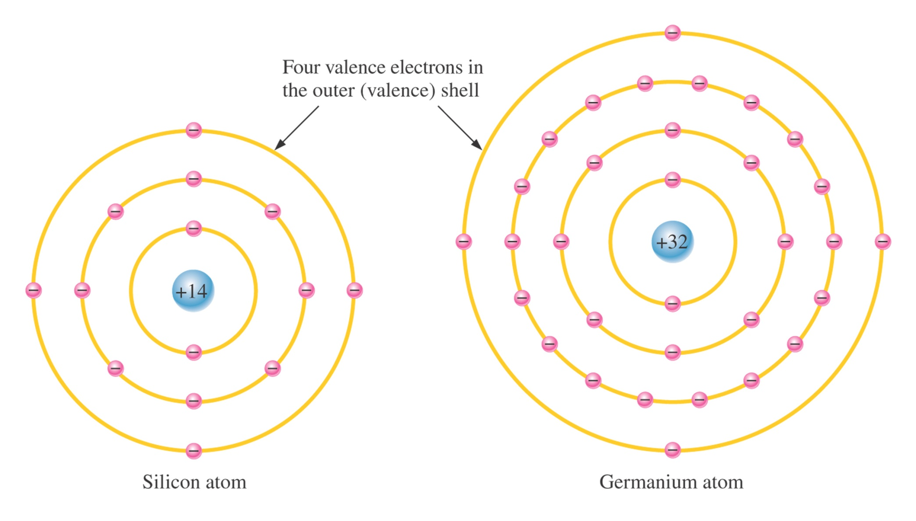
Nucleus

Slide 2
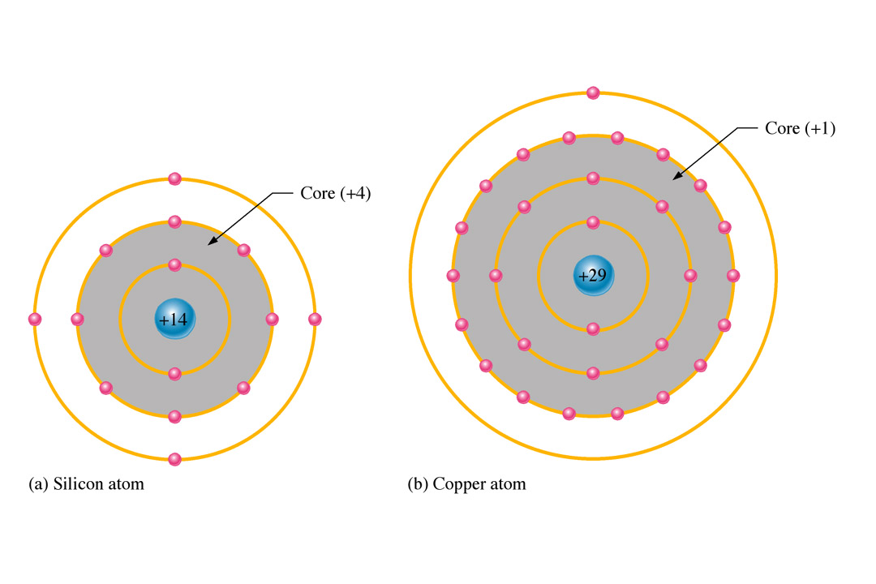
Conductors, Insulators, and Semiconductors
The valence shell determines the ability of material to conduct current.
A Copper atom has only 1 electron in its valence ring. This makes it a good conductor. It takes 29 electrons to fill the valence shell.
A Silicon atom has 4 electrons in its valence ring. This makes it a semiconductor. It takes 18 electrons to fill the valence shell.
Notes:
Fig. 1-6 Copper and Silicon atoms

Slide 3
Covalent Bond
Atoms joined together by an electron sharing process that changes the electrical conductivity of the material, causing each group of atoms to become stable

Slide 4
Semiconductor Crystal
The 4 valence electrons of one atom form a bonding arrangement with adjoining atoms, creating eight shared valence electrons for each atom and producing a state of chemical stability

Slide 5
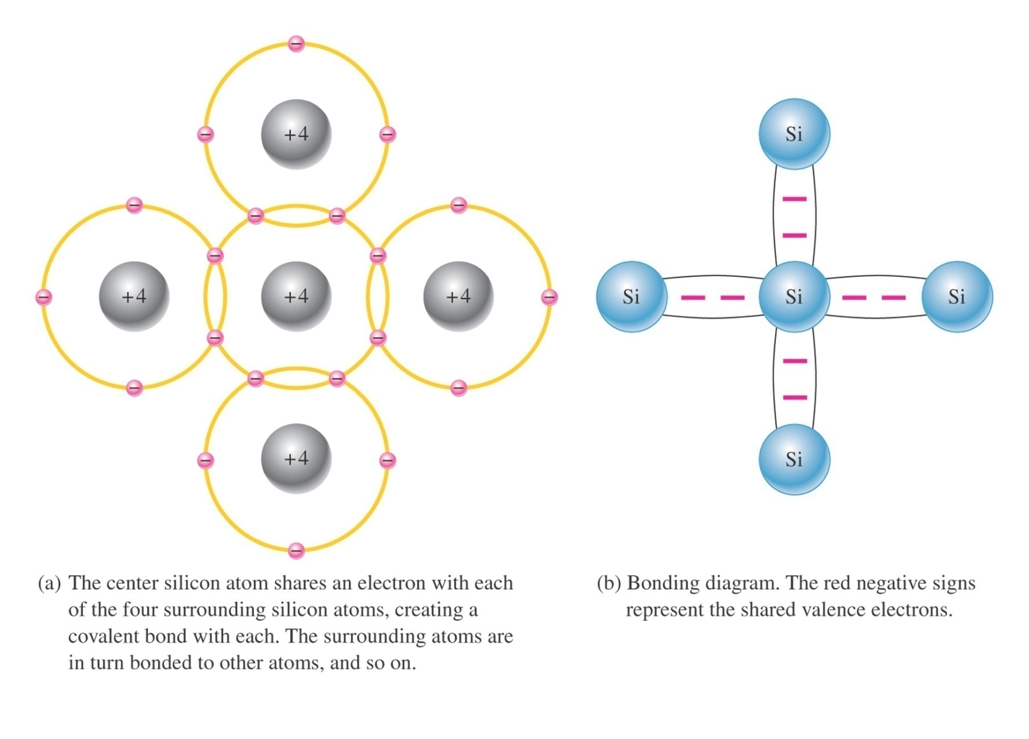
Figure 1–8 Illustration of covalent bonds in silicon.

Slide 6
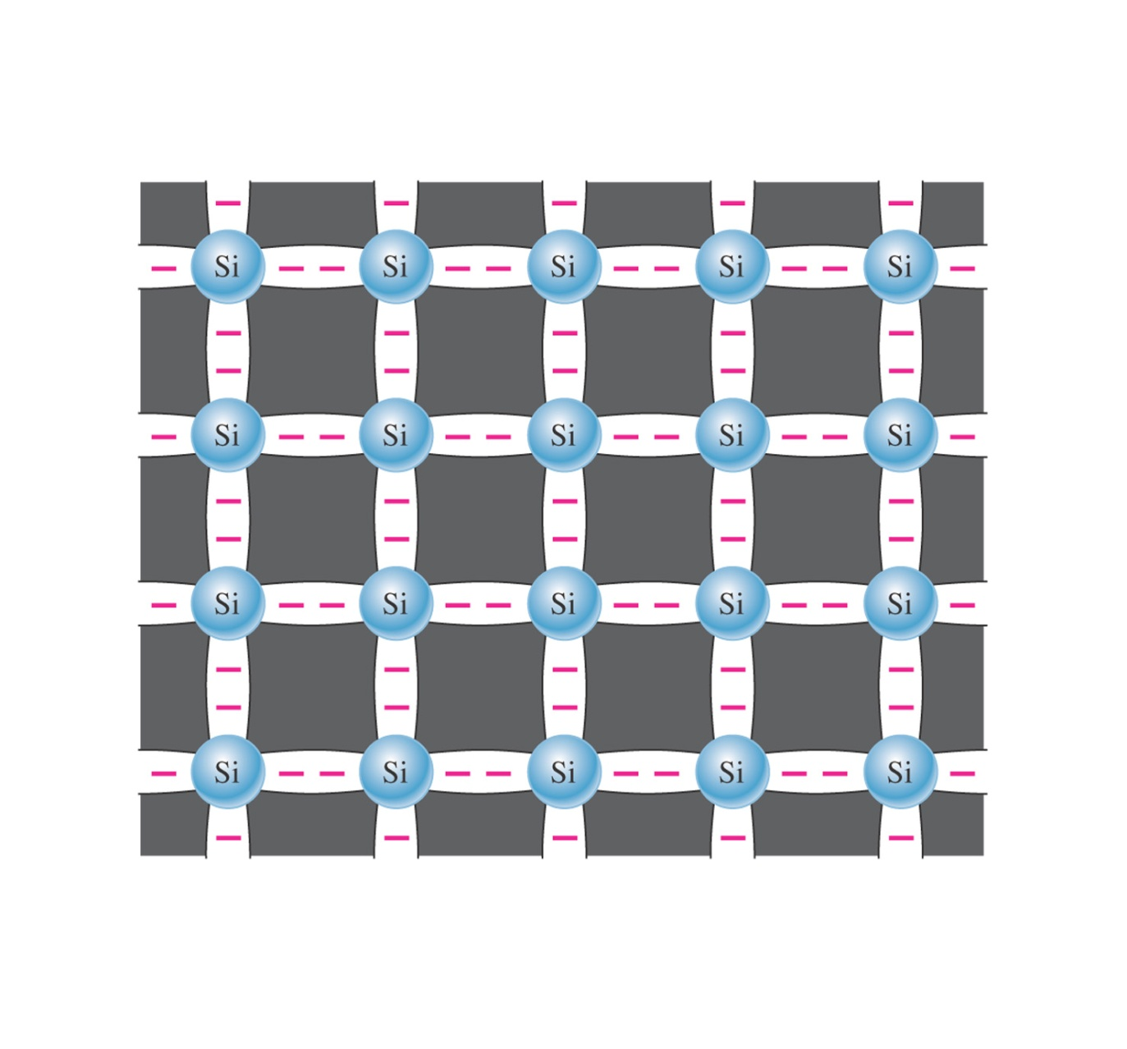
Figure 1–9 Covalent bonds in a silicon crystal.

Slide 7
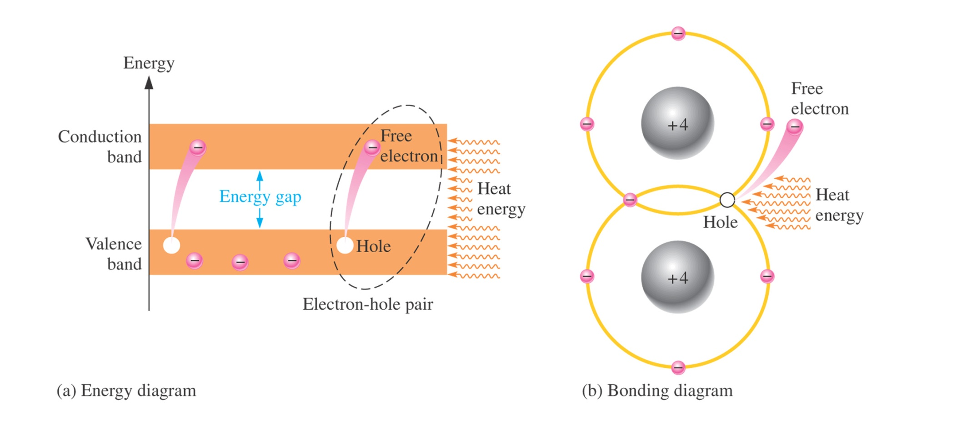

Slide 8
Conduction Electrons
The valence electrons within the crystal structure that manage to escape (becoming free electrons) from their parent atom

Slide 9
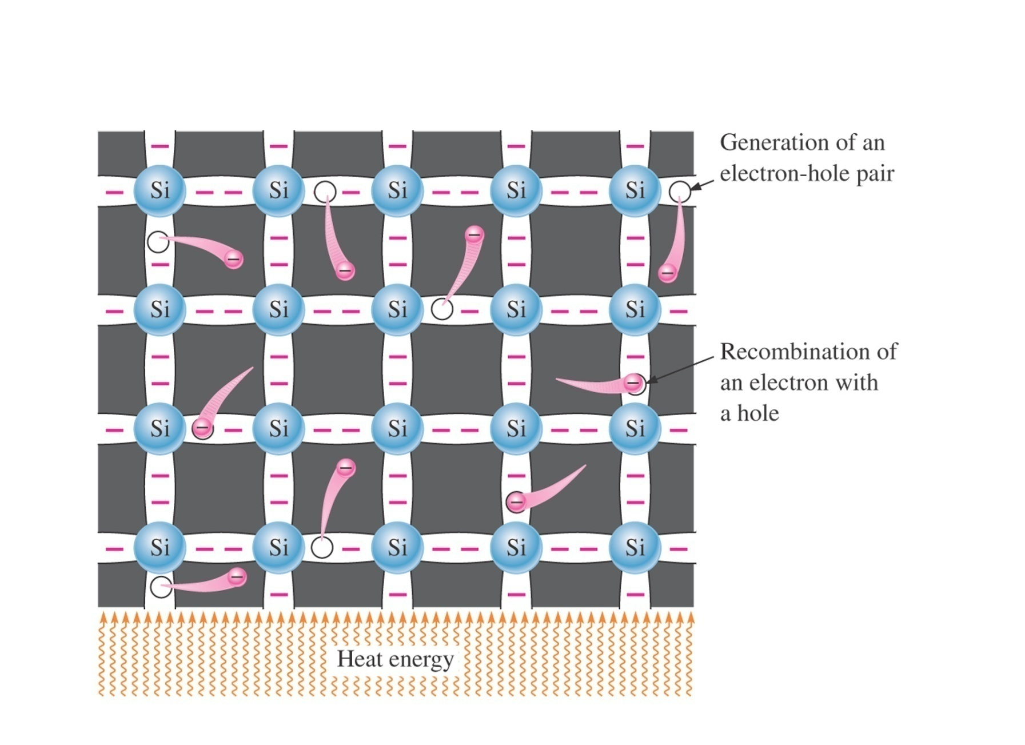
Figure 1–12 Electron-hole pairs in a silicon crystal. Free electrons are being generated continuously while some recombine with holes.

Slide 10
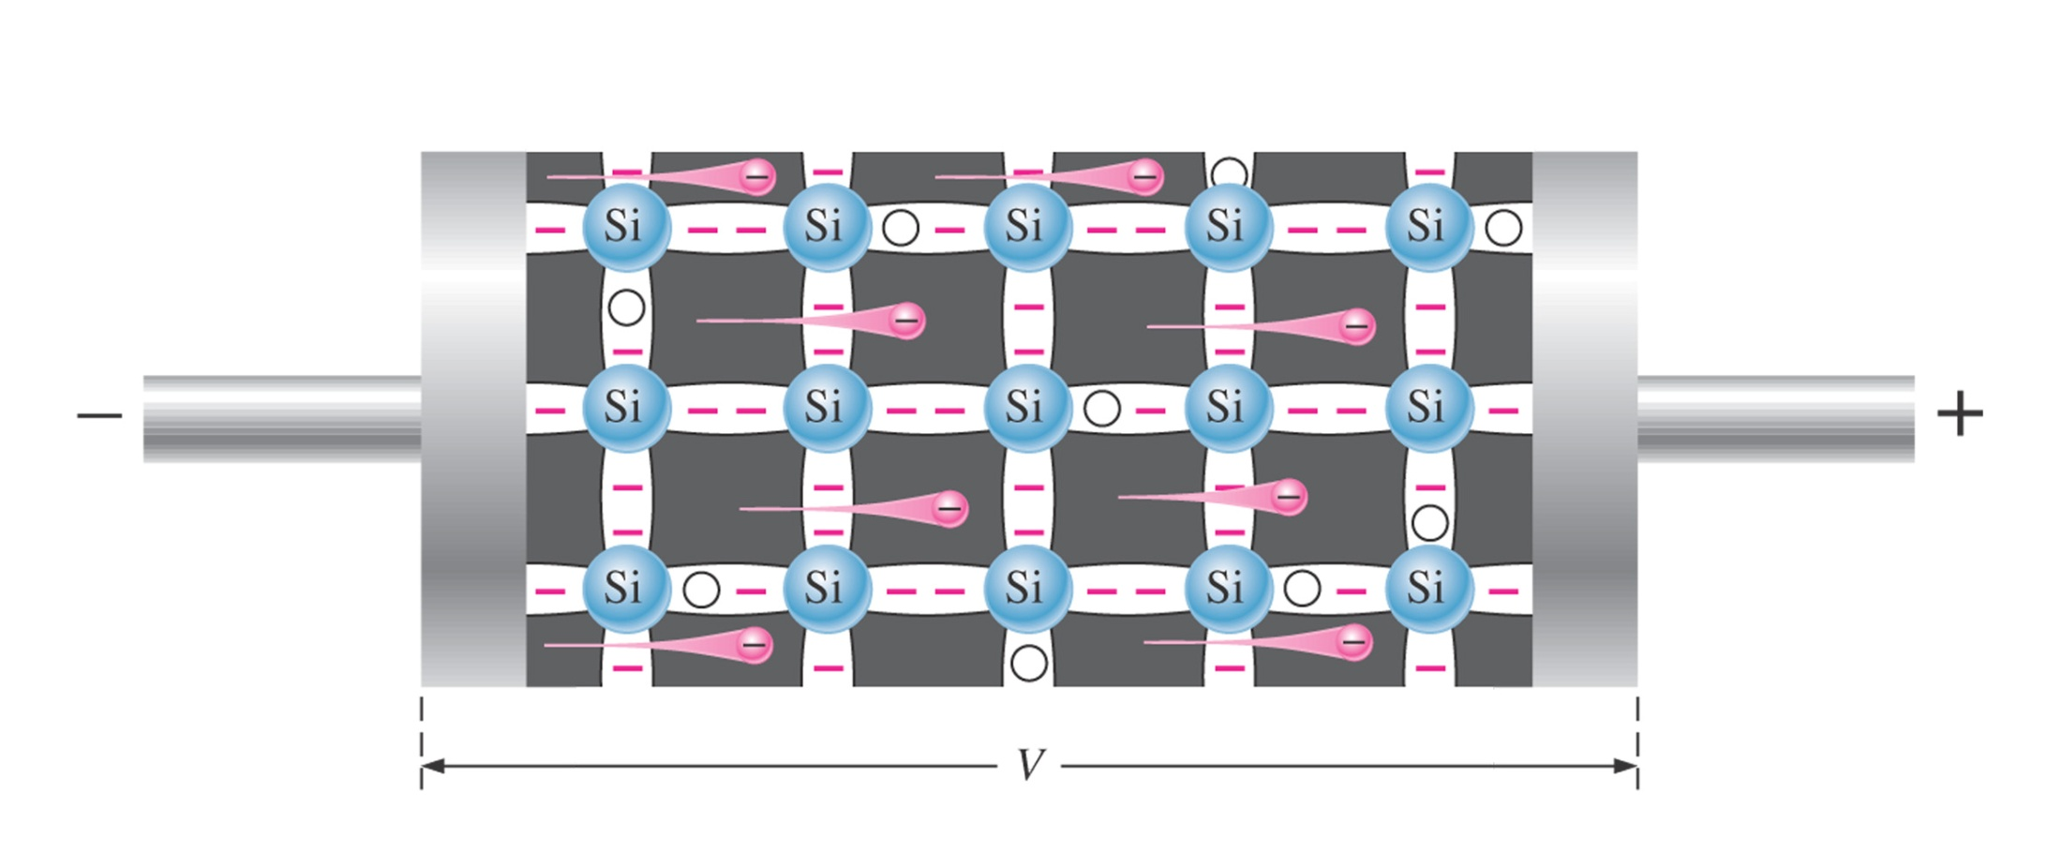
Figure 1–13 Electron current in intrinsic silicon is produced by the movement of thermally generated free electrons.

Slide 11
Intrinsic Semiconductor
A very pure semiconductor crystal (no impurities). Ex.: tetravalent element (Group IV) of periodic table (Germanium & Silicon are two widely used elements for the making of diod, transistor and ICs.
The obvious difference between Germanium and Silicon is the amount of energy required to cross the forbidden gap (Eg for Silicon is 1.1 eV and 0.67 eV for Germanium).
The resistance of a semiconductor material reduced when temperature increased. However, the resistance by the Silicon crystal is higher than the Germanium crystal. That is why Germanium is lesser used in electronic devices.
This is due to the design of the circuit which heat is one of the problem that need to be addressed. Since heat is a parameter that is hard to be controlled, the circuit design must avoid/ reduce the heat generation as much as possible.
All atoms in Group IV have 4 valence electrons. In order to obtain a stable material, every valence electrons is attached to their adjacent neighbor‘s valence electron through the covalent bonding.

Slide 12
Doping
A process of adding other materials called impurities to the semiconductor crystal to change its electrical characteristics

Slide 13
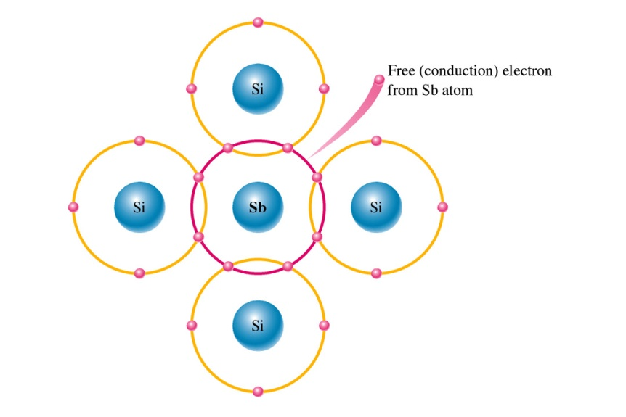
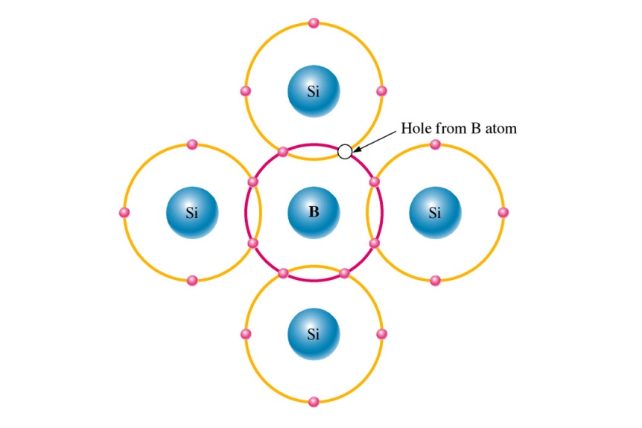
N-type and P-type Semiconductors
The process of creating N- and P-type materials is called doping.
Other atoms with 5 electrons such as Antimony are added to Silicon to increase the free electrons.
Other atoms with 3 electrons such as Boron are added to Silicon to create a deficiency of electrons or hole charges.
N-type
P-type
Notes:
Fig. 1-15 & 16 Pentavalent and Trivalent

Slide 14
Extrinsic Semiconductor
An impure semiconductor.
An extrinsic semiconductor is obtained when an intrinsic semiconductor is doped with impure atom.
Doping is a process of adding impure substance to intrinsic semiconductor material in a controlled manner so that the crystal form does not changed.
Even a ration of 1:10 million of impure substance to intrinsic material, could change the electrical characteristics of a substance.
Almost all semiconductor components are composed from extrinsic semiconductor material.
There are two extrinsic semiconductor types: n and p.
Both of them are obtained by adding impure atoms which has certain electrons valence to the pure material.

Slide 15
N-type Material
N-type material is obtained by adding impure atom which has 5 valence electrons, called as pentavalent atom. Ex.: antimony, arsenic, and phosphorus (Gorup V material).
When impure atom is added to semiconductor material, an excess electron exist in the new material.
This is due to the 5th electron from the impure atom which did not formed any covalent bond with the semiconductor atom.
This electron enters the conduction band as free electron.
No hole is created from this process.

Slide 16
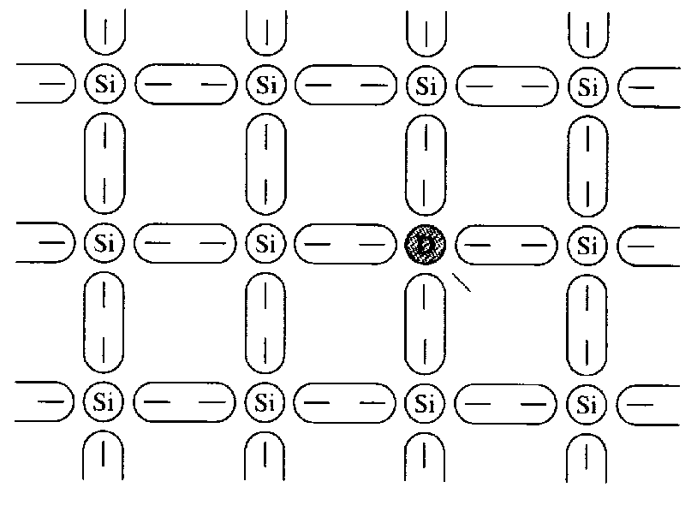
N-type Material
Excess electron
Since the impure atom has donate one excess electron, this impure atom is called donor atom.
This doped donor material is known as n-type material because the free electron has negative charge (negative carrier)
When the pentavalent impure atom donate its excess electron, it looses one electron.
This process caused the atom becomes unstable because the number of electron is no longer the same as the proton.
Figure 1.10: Crystal structure consisting donor atom

Slide 17
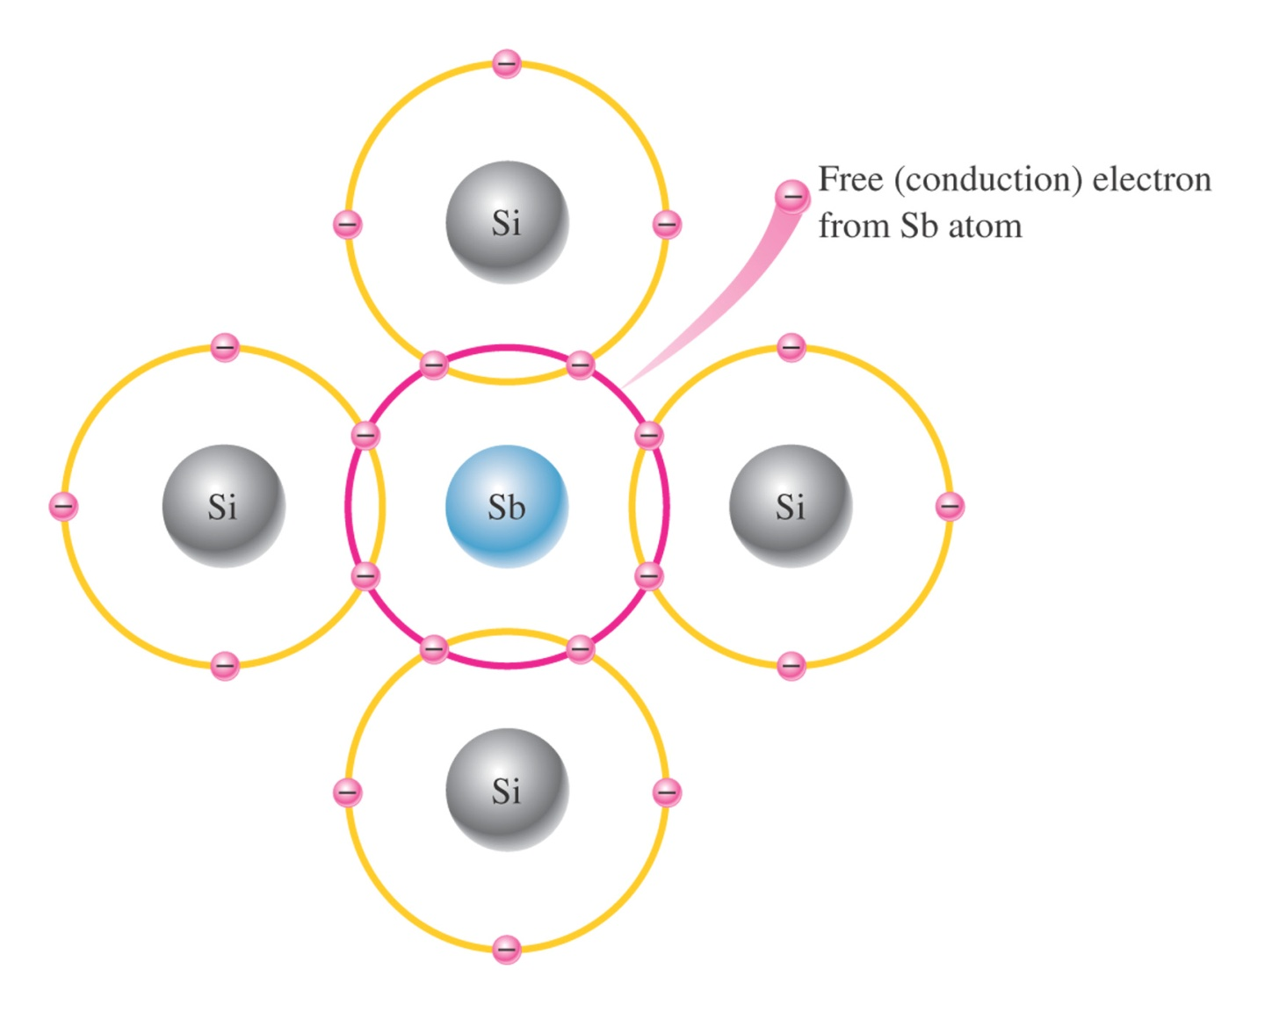
Figure 1–15 Pentavalent impurity atom in a silicon crystal structure. An antimony (Sb) impurity atom is shown in the center. The extra electron from the Sb atom becomes a free electron.

Slide 18
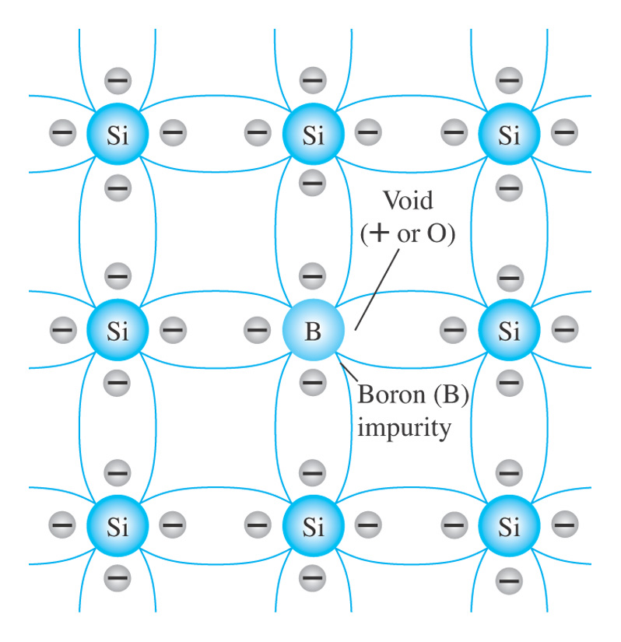
Fig. 1.9 Boron impurity in p-type material.

Slide 19
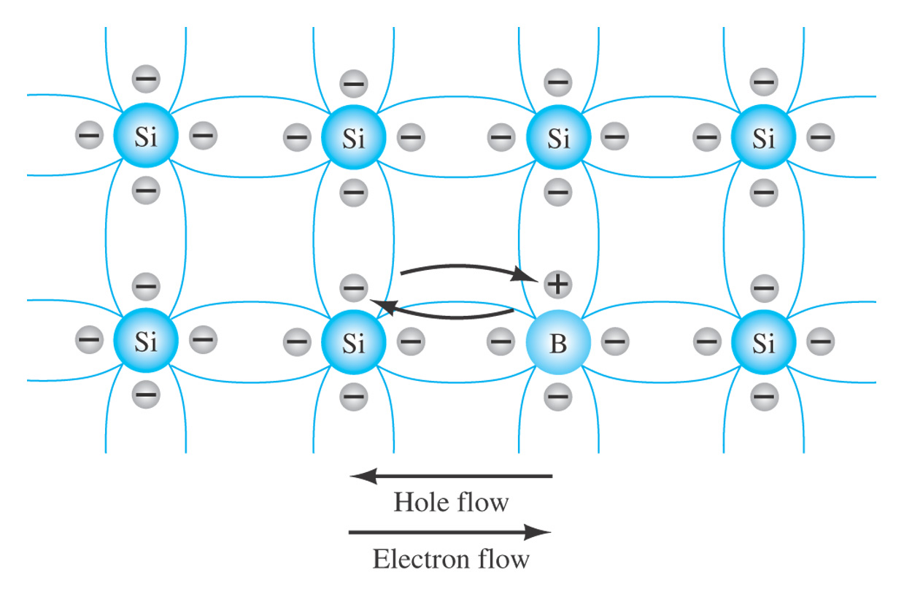
Fig. 1.10 Electron versus hole flow.

Slide 20
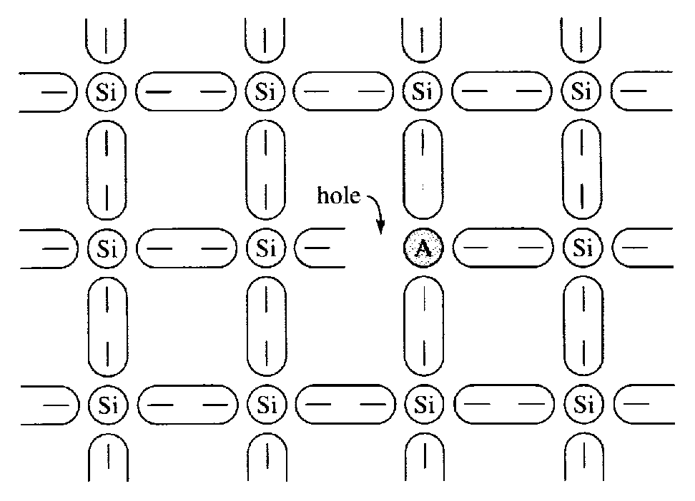
P-type Material
If an impure atom for Group III was added to intrinsic semiconductor material, p-type material will be obtained.
Impure atom of Group III (trivalent atom): Boron, Aluminium, Indium and Gallium has 3 valence electrons.
When trivalent atom make a bonding to the semiconductor material‘s atom, only 3 bonds are formed.
These bonds lack one electron to complete the outest shell with 8 electrons. As a consequence, a hole is formed (positive charge carrier).
No free electron produced through this process.
Figure 1.11: Crystal structure consisting acceptor atom.

Slide 21
P-type material
Since there exist a hole, the trivalent atom is ready to accept electron, thus it is called as an acceptor atom.
The increase of positive charge carrier caused the material been classified as p-type.
When the trivalent impure atom received an electron, it becomes unstable because the number of electron is more than the proton.
This process has changed the acceptor atom to negative ion or acceptor ion.

Slide 22
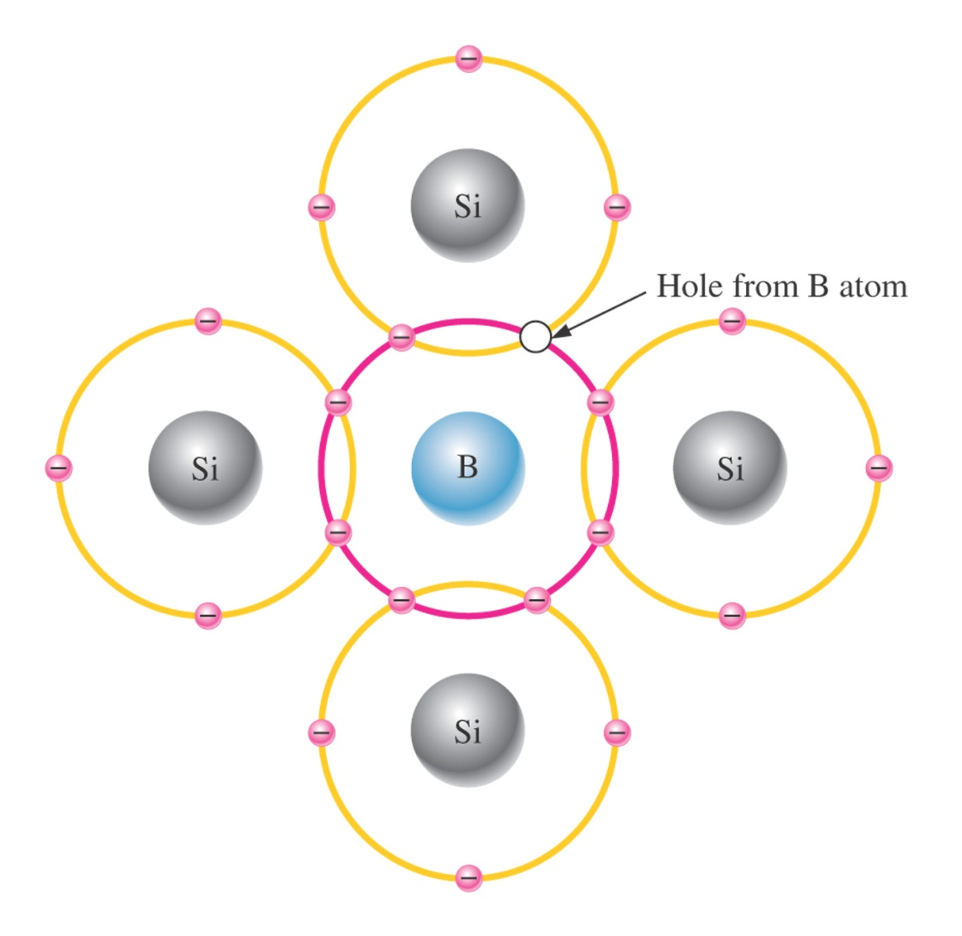
Figure 1–16 Trivalent impurity atom in a silicon crystal structure. A boron (B) impurity atom is shown in the center.

Slide 23
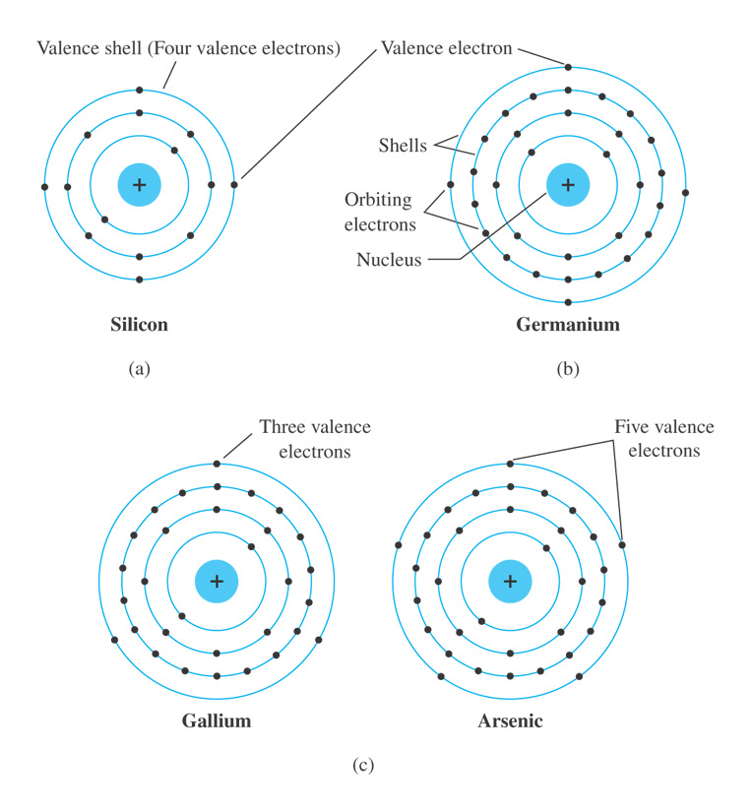
Fig. 1.3 Atomic structure of (a) silicon; (b) germanium; and (c) gallium and arsenic.

Slide 24
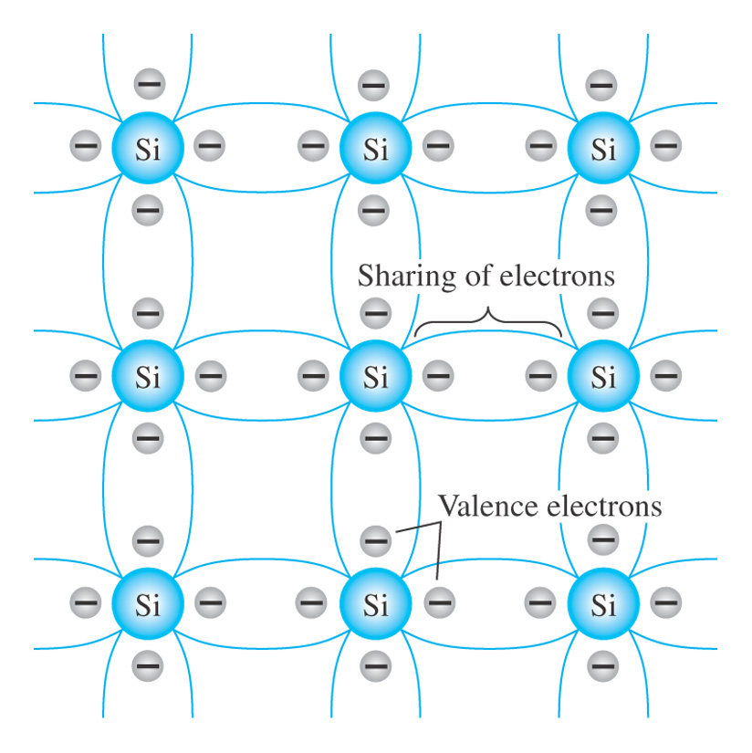
Fig. 1.4 Covalent bonding of the silicon atom.

Slide 25
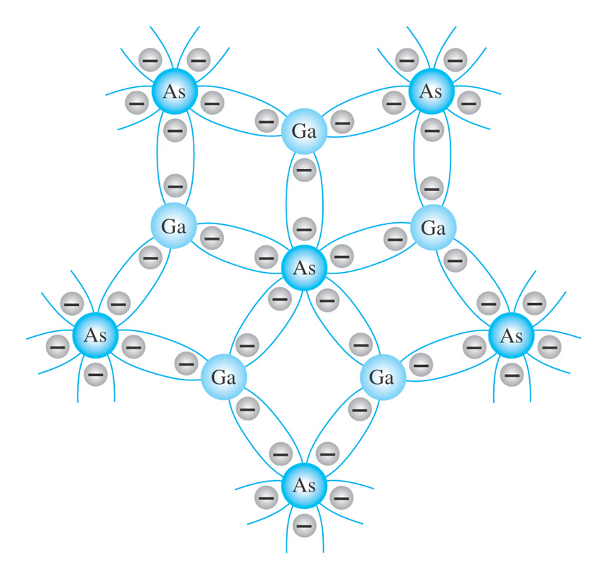
Fig. 1.5 Covalent bonding of the GaAs crystal.

Slide 26
Majority and Minority Carrier
At low temperature, n-type extrinsic semiconductor has many free electrons as its current carrier, while p-type has many holes.
These current carriers are the majority and minority carriers of the material.
At room temperature or higher, negative and positive charge carriers are created because electrons are freed from its orbit.
Hence, there exist a few hole in n material and electron in p material.
This few carriers called minority carrier and it increases as the temperature increased.

Slide 27
Movement of Charge Carrier
There are 2 ways how hole and electron move in semiconductor material:
Diffusion
A process where the carriers (in high density region in a semiconductor crystal) will disperse themselves to achieve a uniform concentration
Drift Current
results when available charge carriers move under the influence of an applied electric field

Slide 28
Movement of Charge Carrier (Diffusion)
Diffusion occurs when two material with different concentration is mixed. When they are fully mixed, the concentration is uniform.
For example, if a drop of ink fall into clean water, the ink concentration is spread out to bigger area until the concentration is uniform across the water.
As in a semiconductor material, charge carrier (either hole or electron) from the high concentration area will move to the low concentration area until the concentration of the charge carriers is uniform.
Due to the movement to balance the charge concentration, charge transfer occurs and cause the generation of electrical current.
This current called the diffusion current because the charge carrier diffused from one area to the other.

Slide 29
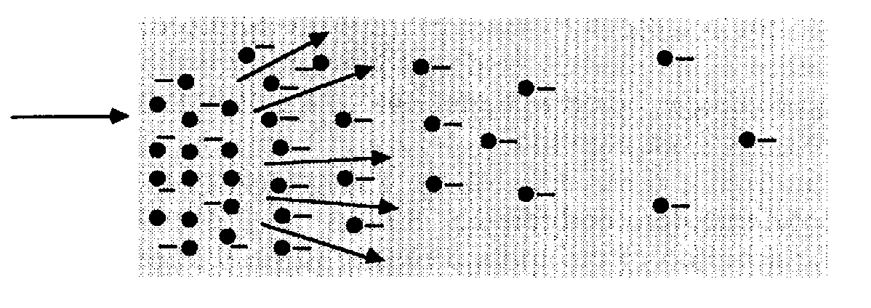
Drift Current
Drift current
Concentration of
carrier electrons
Drift current created when charge carrier is under the control of electric field.
Free electrons moves to the positive terminal of the applied voltage source.
During the movement, free electrons might bump with other atoms. Every time it bumps, it will bounce randomly. However, the existence of electric field, the free electrons drift toward the electric force applied, which is towards the positive terminal.
In brief, drift current is propotional to the applied electric (Ohm‘s Law).

Slide 30
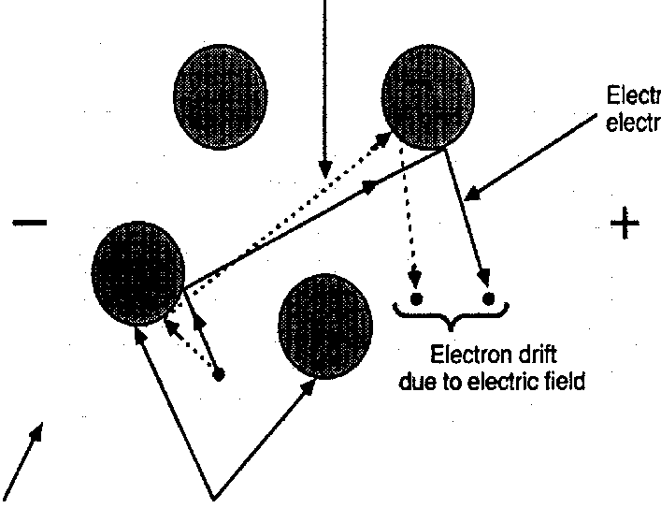
Figure 1.13 : Drift current
electron path without electric field
electron path with electric field
Electron drift caused by electric field
atom

Slide 31
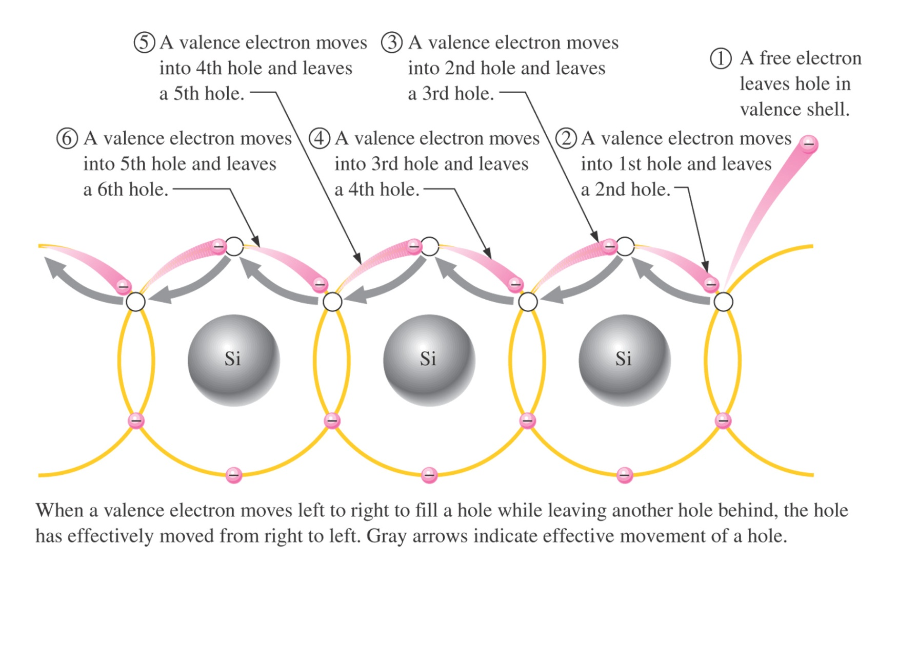
Figure 1–14 Hole current in intrinsic silicon.

Slide 32
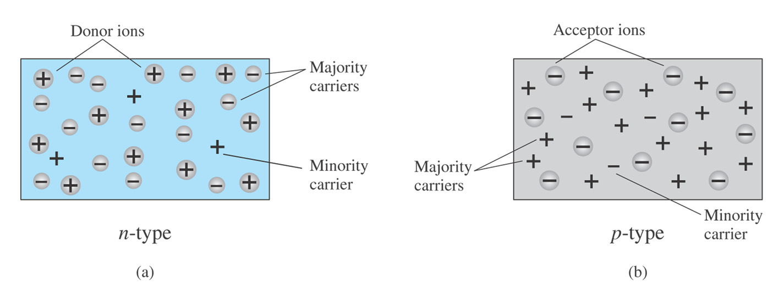
Fig. 1.11 (a) n-type material; (b) p-type material.

Slide 33
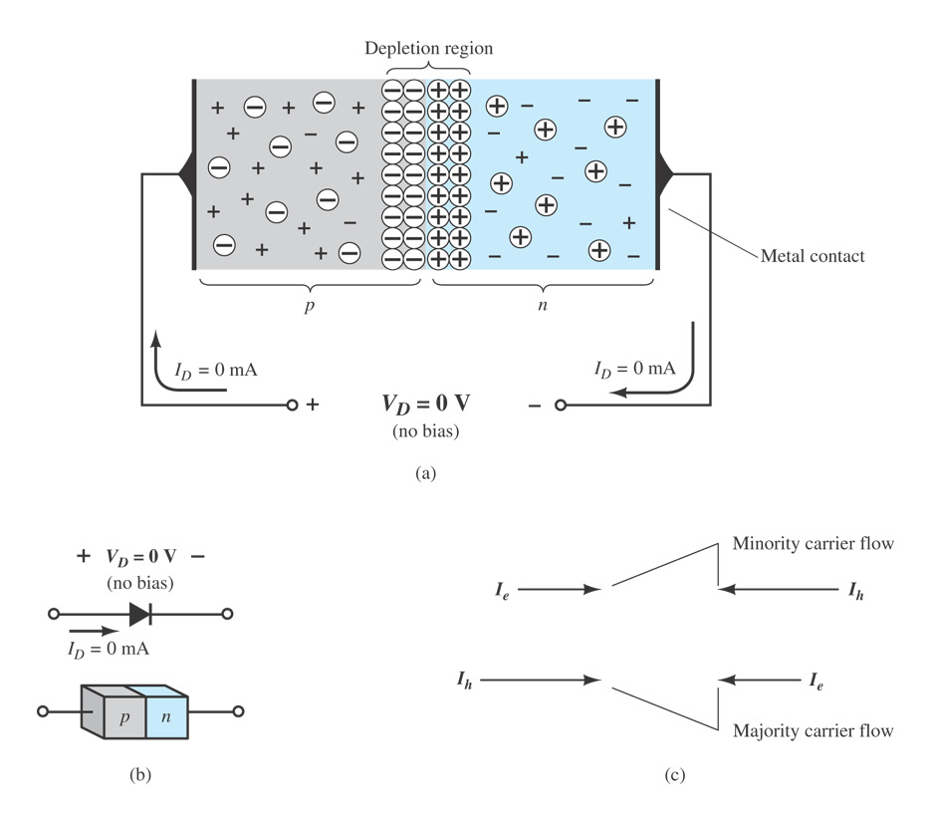
Fig. 1.12 A p–n junction with no external bias. (a) An internal distribution of charge; (b) a diode symbol, with the defined polarity and the current direction; (c) demonstration that the net carrier flow is zero at the external terminal of the device when V_{D} = 0 V.

Slide 34
How Defects Lead to Devices
PN Junctions = Diodes
n-type
p-type
Fermi level in n-type
semi-conductor is at
higher energy than
for the p-type:
Spontaneous flow of electrons
in one direction only.
ε_{f}
ε_{f}
small
band
gap
Directional Flow of electrons -->
current goes in one direction only

Slide 35
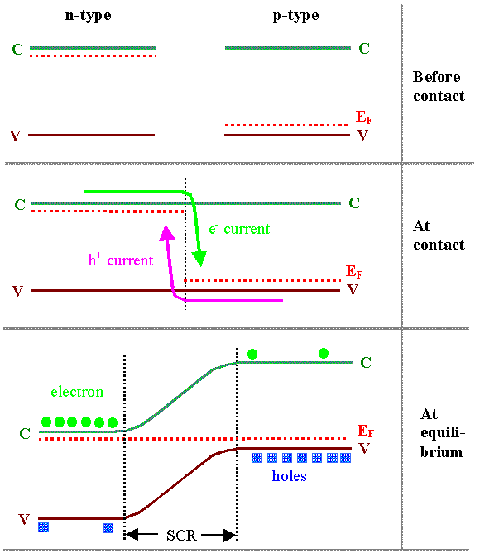
In a pn junction,
current spontaneously
flows in one direction

